Slide 1


A Mathematical Introduction to Data Science Lecture 3: Geometric and Topological Methods
Yuan Yao
Peking University
2015.5.7.
Slides are put at Baidu cloud: http://pan.baidu.com/s/1eQpiwvg

Slide 2
Main Content
Lecture 1: Sample mean and Covariance (PCA/MDS): Fisher’s Principle of Maximum Likelihood Estimate, yet things might go wrong --
Stein’s phenomenon and shrinkage
Random matrix theory and failure of PCA
Lecture 2: Beyond PCA/MDS
Random projections and compressed sensing
Semidefinite Programming (SDP) extensions of PCA/MDS:
Robust PCA
Sparse PCA
MDS with uncertainty (Sensor Network Localization)
Lecture 3: Geometric and Topological structures of data
Manifold learning: ISOMAP/LLE etc.
From graphs to simplicial complexes: persistent homology, Hodge theory, etc.

Slide 3
Geometric and Topological Methods
Differential geometry
Data distribution: manifold learning (nonlinear dimensionality reduction, LLE (Roweis, Saul etal), ISOMAP (Tennenbaum etal), Laplacian eigenmap (Niyogi, Belkin etal), Hessian LLE (Donoho et al), Diffusion map (Coifman, Singer-Wu et al))
Models: information geometry (S. Amari et al.)
Algebraic geometry
Data: algebraic variety (MDS is Sum-of-Squares), tensor, etc.
Models: discrete graphical models (Bernd Sturmfels, UCB; Mathias Drton, U Washington)
Integral geometry
Gaussian random fields and Euler Calculus: Jonathan Taylor (Stanford)
Euler Calculus on graphs: Rob Ghrist (UIUC - U Penn)
Algebraic topology
Persistent homology: Herbert Edelsbrunner (Duke - Institute of Sci. Tech. Austria), Gunnar Carlsson (Stanford), et al.
Hodge Theory: a bridge between differential geometry and algebraic topology

Slide 4
Geometric and Topological Data Analysis
General area of geometric data analysis attempts to give insight into data by imposing a geometry (metric) on it
manifold learning: global coordinate preserving local structure
metric learning: find a metric accounting for similarity
Topological method is to study invariants under metric distortion
clustering as connected components
loops, holes
Between them, lies in Hodge Theory, a bridge over geometry and topology
0-dimensional Hodge Theory: Laplacian eigenmaps, Diffusion Maps
1-dimensional Hodge Theory: Preference Aggregation, Game Theory

Slide 5
Manifold Learning and Nonlinear Dimensionality Reduction
ISOMAP
LLE
Diffusion Map, Laplacian Eigenmap
Hessian LLE
LTSA
VDM

Slide 6
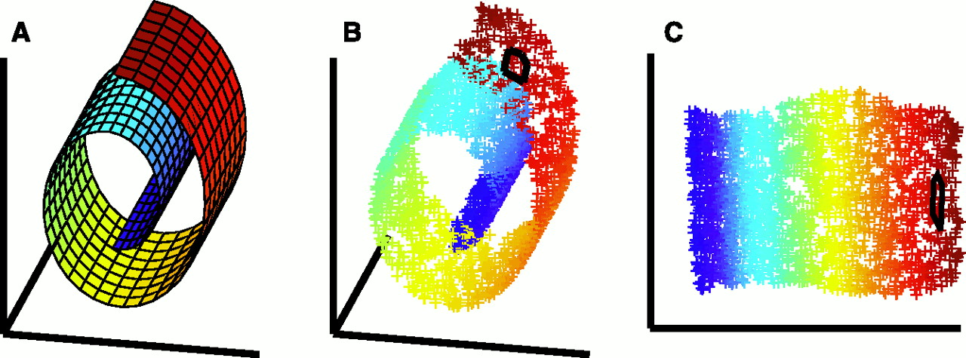
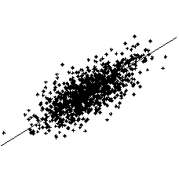
Dimensionality Reduction
Data are concentrated around low dimensional Manifolds
Linear：MDS, PCA
NonLinear: ISOMAP, LLE, …

Slide 7
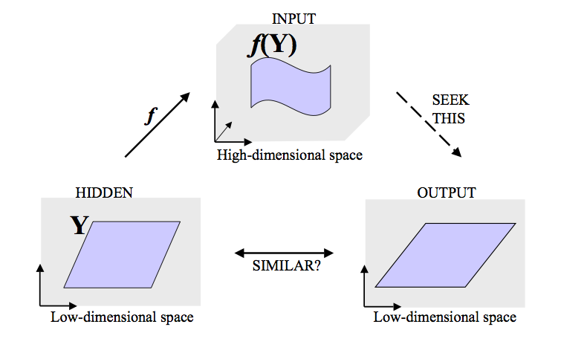
Generative Models in Manifold Learning

Slide 8
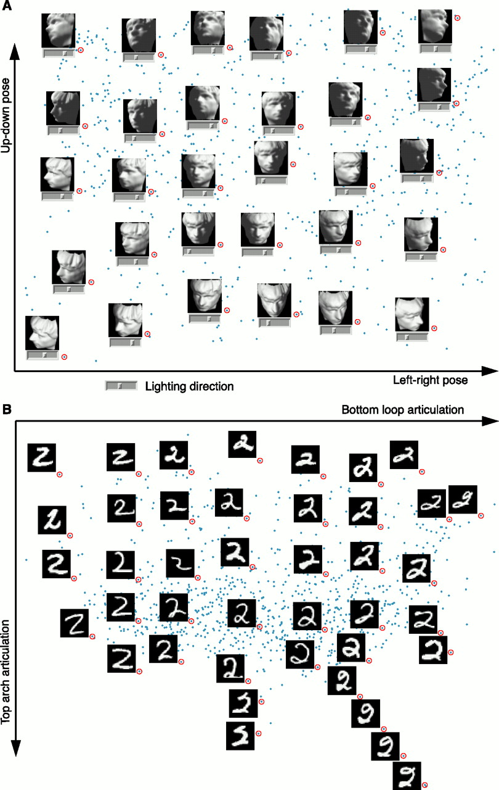
Example…

Slide 10
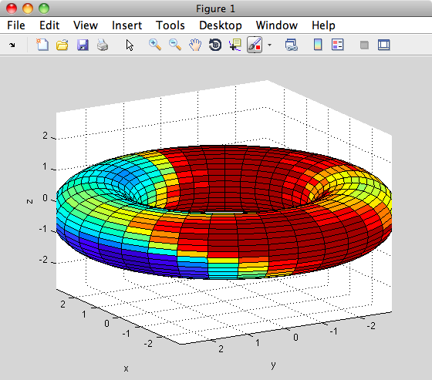
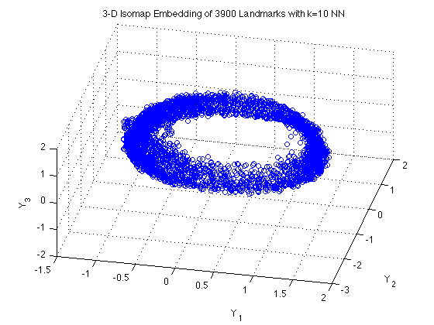
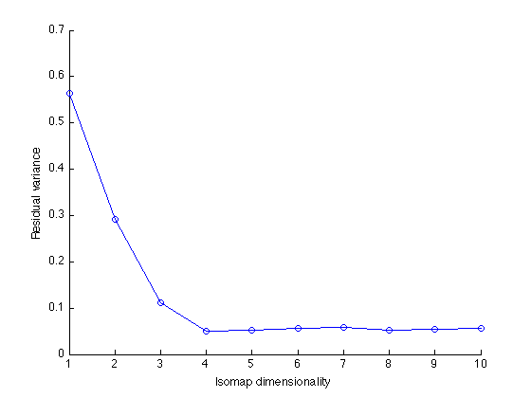
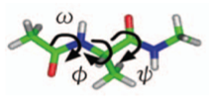
Biomolecular: Alanine-dipeptide
ISOMAP 3D embedding with RMSD metric on 3900 Kcenters

Slide 11
Meta-Algorithm: Kernel PCA
Construct a neighborhood graph
Construct a positive semi-definite kernel function/matrix
Find the eigen-decomposition
Kernel
Spectrum

Slide 12
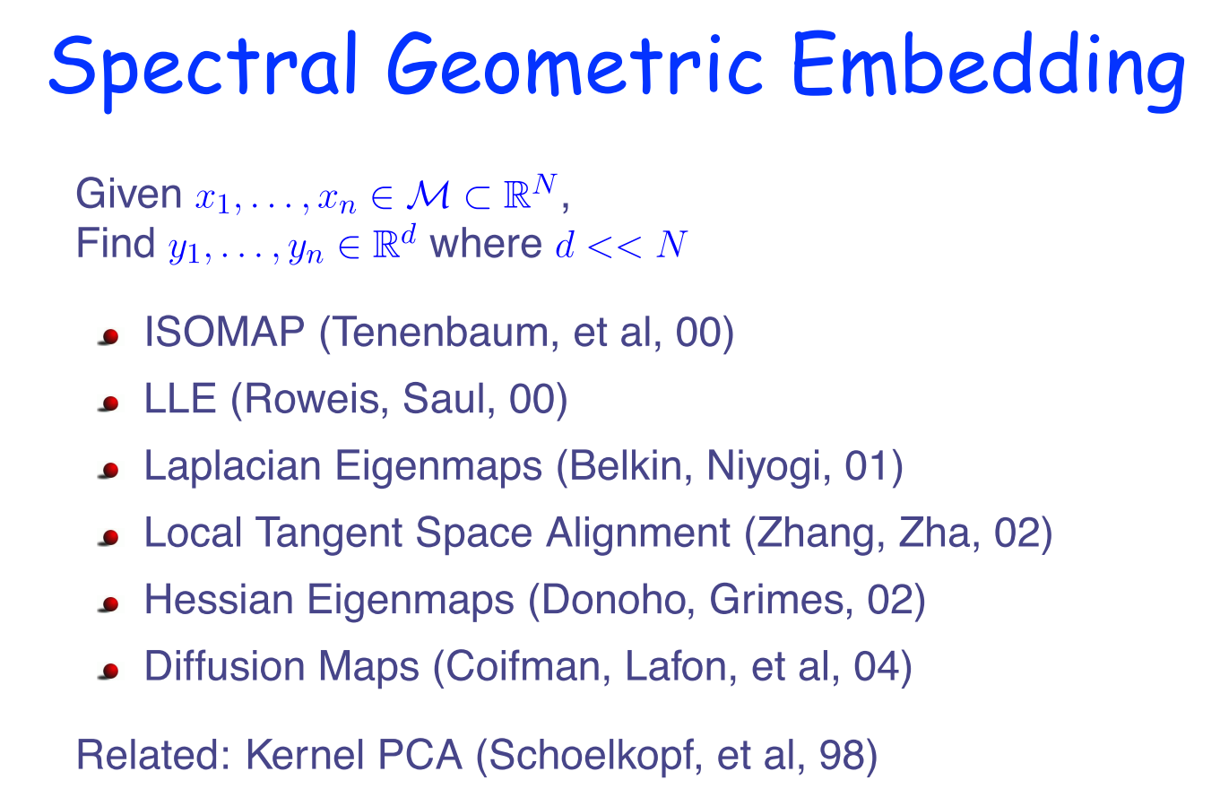

Slide 13
Nonlinear Manifolds..
A
PCA and MDS see the Euclidean
distance
What is important is the geodesic distance
Unfold the manifold

Slide 14
Two Basic Geometric Embedding Methods
Tenenbaum-de Silva-Langford Isomap Algorithm, Science 2000
Global approach.
On a low dimensional embedding
Nearby points should be nearby.
Faraway points should be faraway.
All pairwise geodesic distances (approximated by graph shortest path distance) are preserved
Roweis-Saul Locally Linear Embedding Algorithm, Science 2000
Local approach
Nearby points nearby (‘fit locally, think globally’)

Slide 15
Recall: MDS
Idea: Distances -> Inner Products -> Embedding
Inner Product:
K is positive semi-definite with

Slide 16
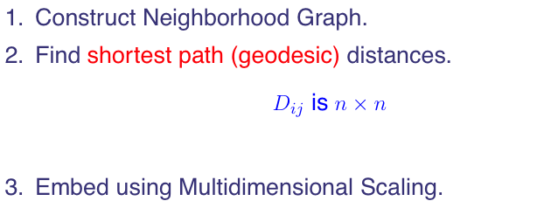
ISOMAP [Tennenbaum-DeSilva-Langford’00]

Slide 17
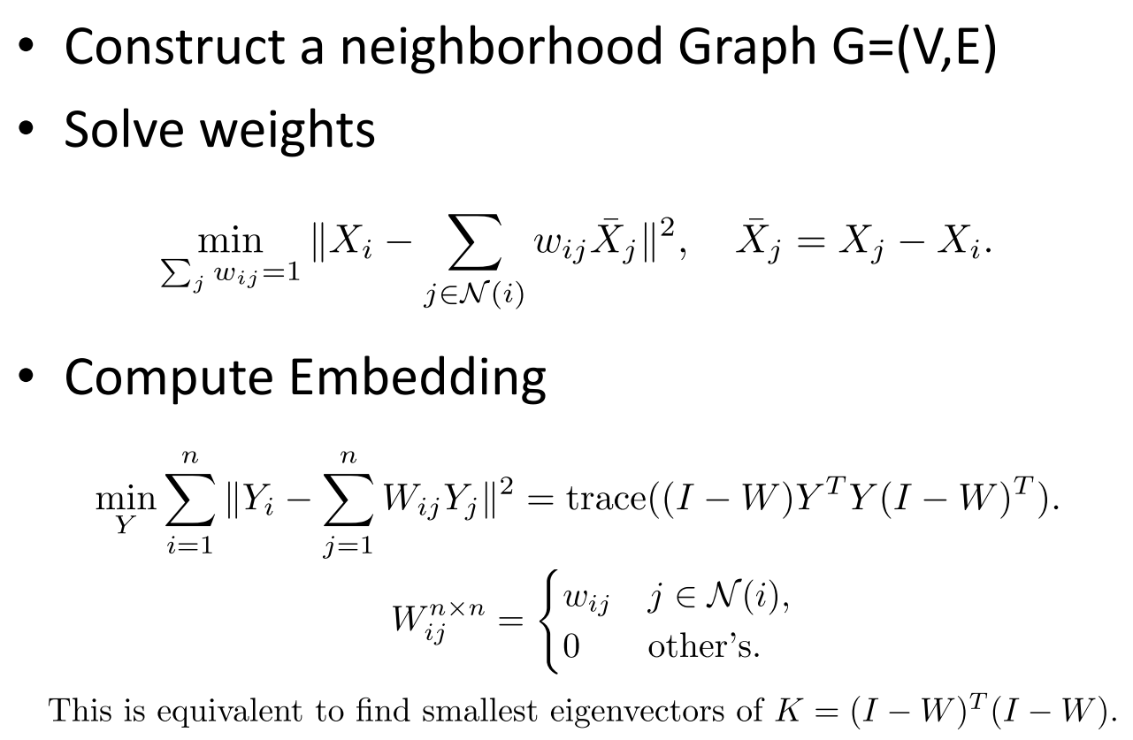
LLE (Locally Linear Embedding)

Slide 18
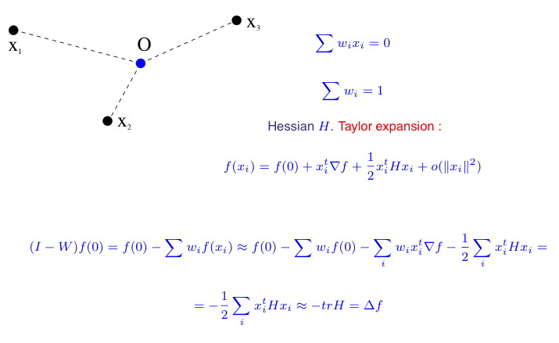
Laplacian LLE

Slide 19
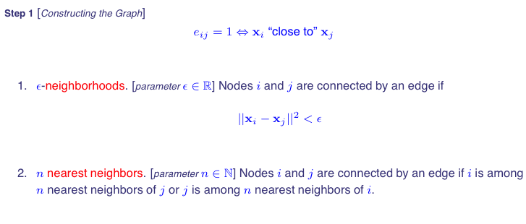
Laplacian Eigenmaps (I) [Belkin-Niyogi]

Slide 20
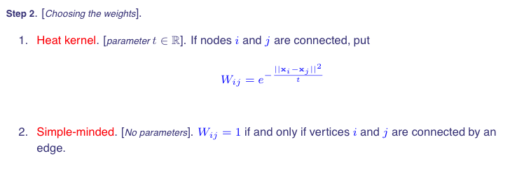
Laplacian Eigenmaps (II)

Slide 21
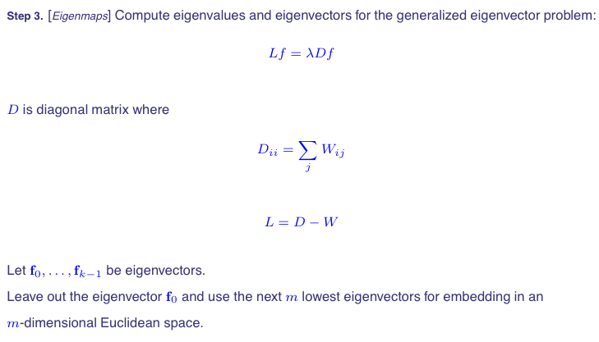
Laplacian Eigenmaps (III)

Slide 22
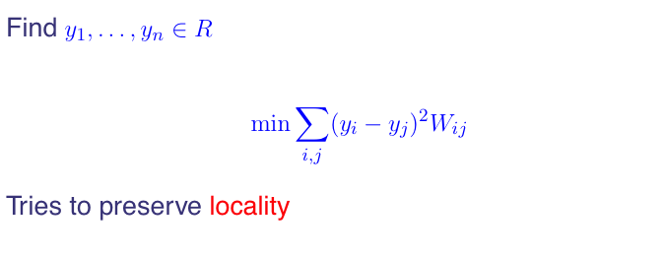
Justification

Slide 23
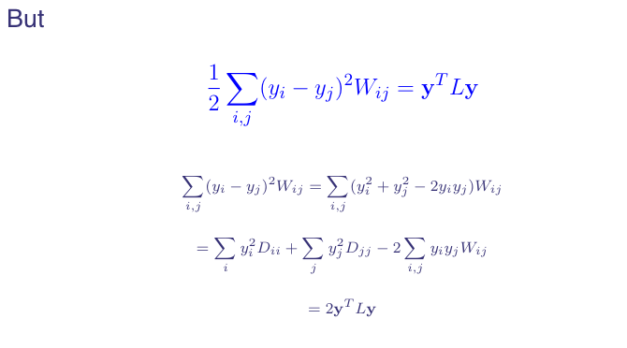
A Fundamental Identity

Slide 24
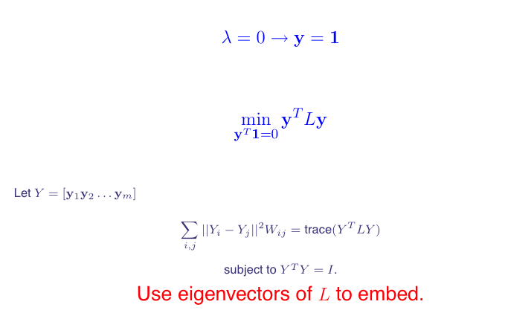
Embedding as Unnormalized Laplacian Eigenmaps

Slide 25
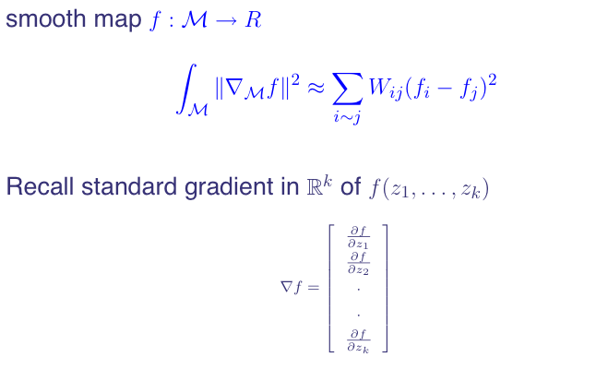
On the Manifold

Slide 26
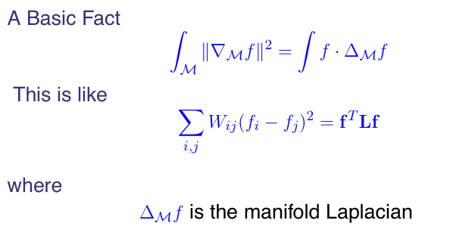
Stokes Theorem

Slide 27
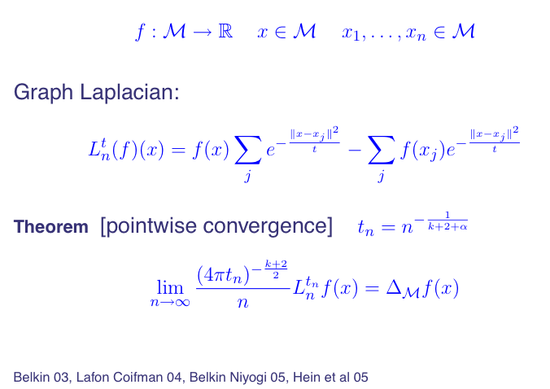
From Graph to Manifolds: Pointwise Convergence

Slide 28
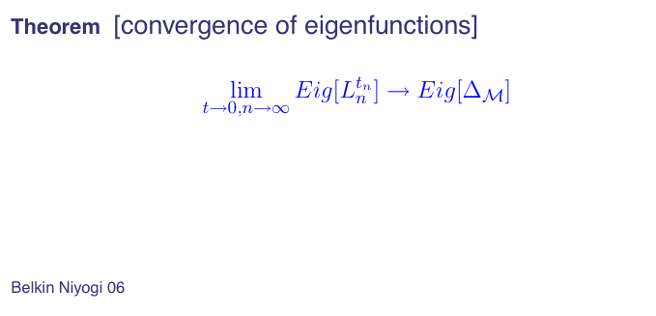
From Graph to Manifolds: Spectrum Convergence

Slide 29
Connections to Markov Chain
L = D-W: unnormalized graph Laplacian
L_{n}=D^{-1/2} L D^{-1/2}: normalized graph Laplacian
P = I - D⁻¹L = D⁻¹W is the markov matrix
v is generalized eigenvector of L: L v = λ D v
v is also a right eigenvector of P with eigenvalue 1-λ
D^{1/2} v is eigenvectors of L_{n} with eigenvalue λ
P is lumpable iff v is piece-wise constant
So v is the most often choice of Laplacian eigenmaps and Diffusion Map

Slide 30
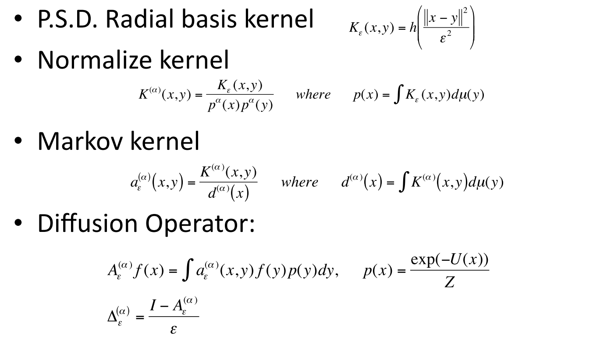
Diffusion Map
Gaussian kernel
Normalized kernel
Diffusion/Laplacian kernel
α=1, Laplacian-Beltrami operator, separate geometry from density
α=0, classical normalized graph Laplacian
α=1/2, backward Fokkar-Planck operator
Coifman-Lafon 2006. Diffusion Maps.

Slide 31
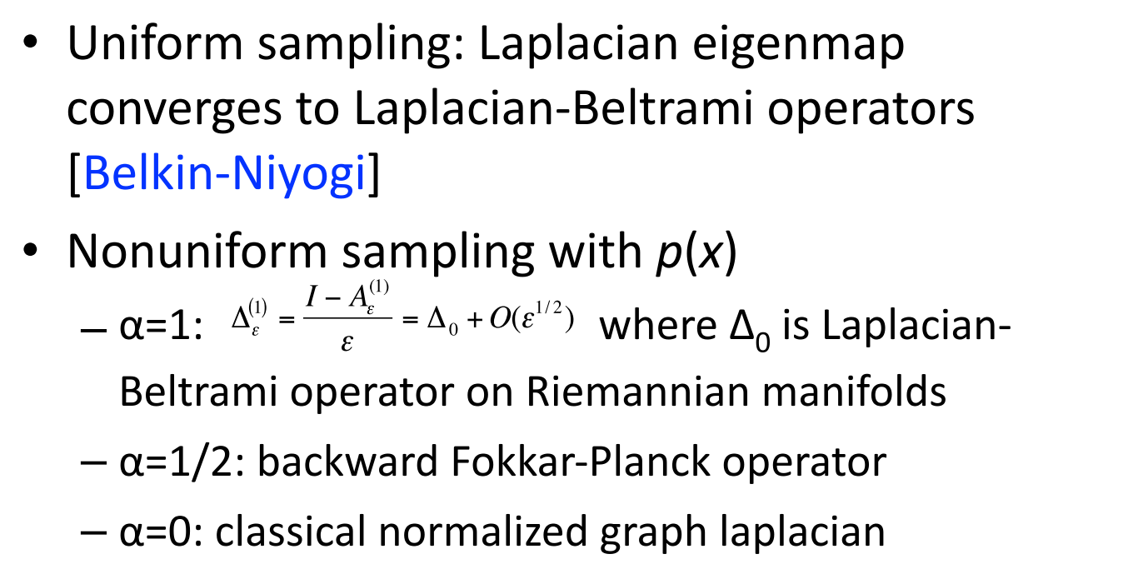
Convergence of Diffusion Map [Coifman-Lafon’06]

Slide 32
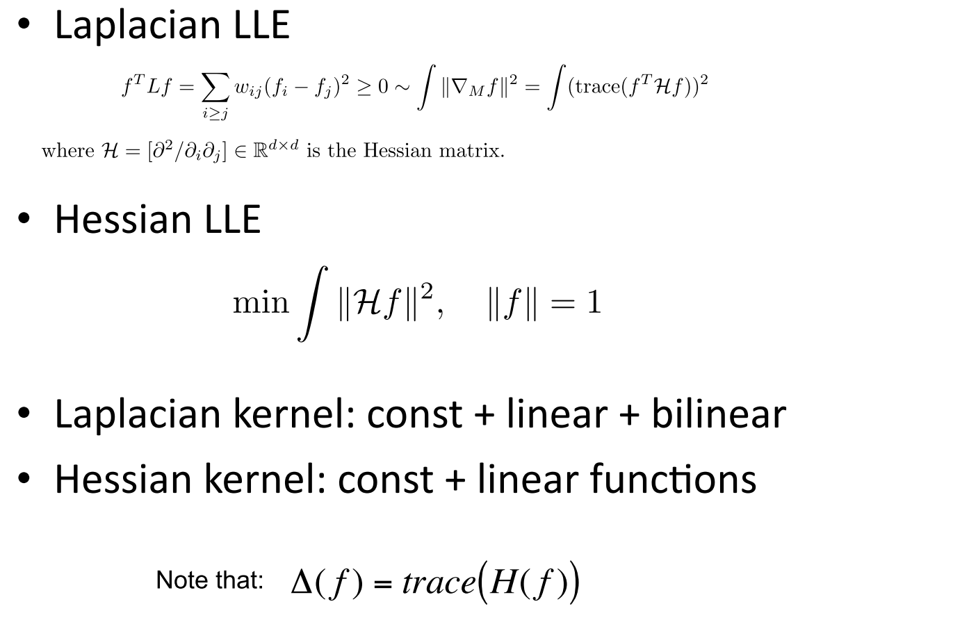
Hessian LLE (Donoho-Grimes’03)

Slide 33
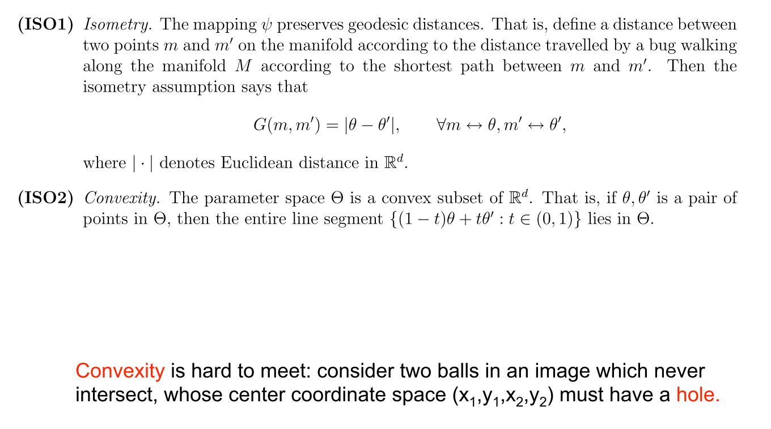
Two assumptions in ISOMAP

Slide 34
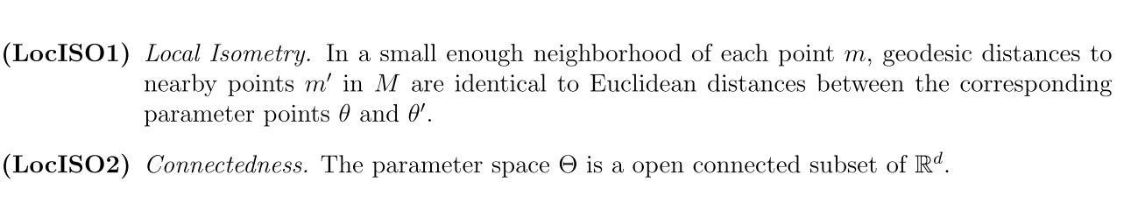
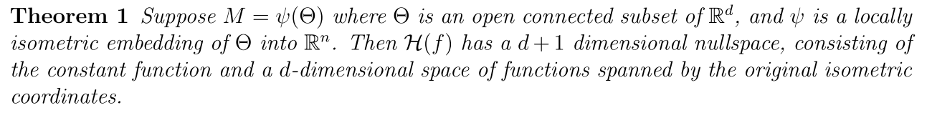
Relaxations in Hessian LLE

Slide 35
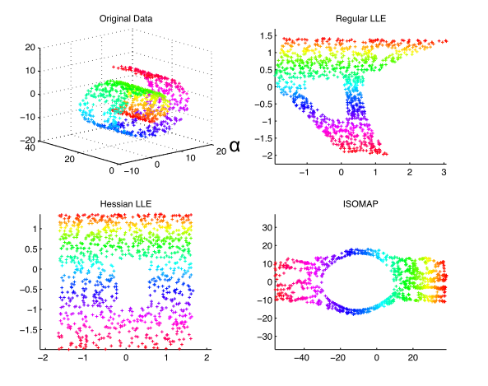
Comparisons on Swiss Roll with hole

Slide 36
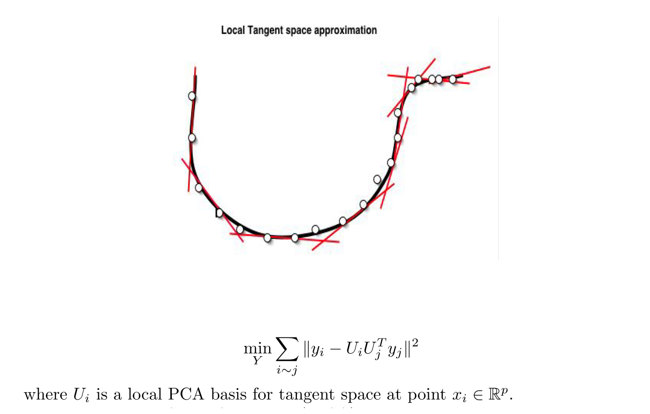
Local Tangent Space Alignment [Zha-Zhang’05]

Slide 37
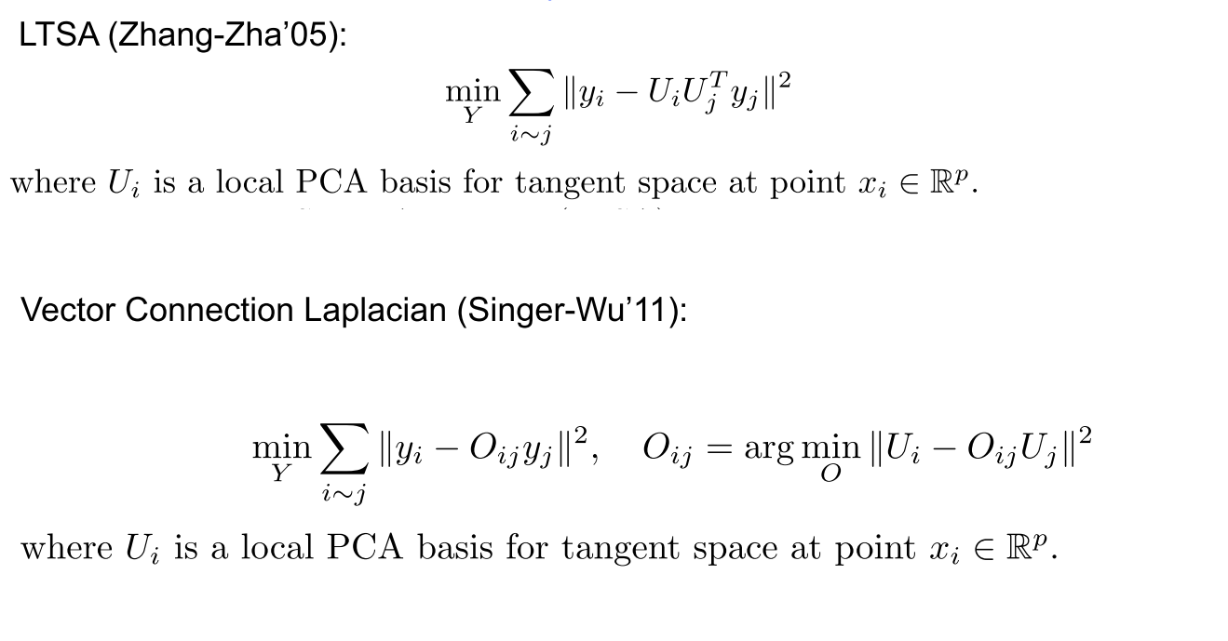
From LTSA to Connection Laplacian
Second order convergence to connection Laplacian is possible [Hau-Tieng Wu]

Slide 38
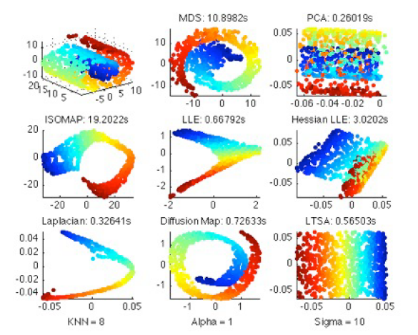
Comparisons on Swiss Roll

Slide 39
Summary
Manifold Learning
ISOMAP: global, provable, slow
LLE: local, fast, yet not provable
Laplacian LLE: local, fast, provable convergence to Laplacian-Beltrami operator
Diffusion Map: local, fast, more general than Laplacian LLE, random walk
Hessian LLE: local, fast, find isometric linear coordinates, unstable
LTSA: local, fastest, first order convergence
Vector Diffusion Map: local, second order convergence to Connection Laplacian

Slide 40
From Graph to Complexes: Topological and Geometric Approach
Persistent Homology
Hodge Theory

Slide 41
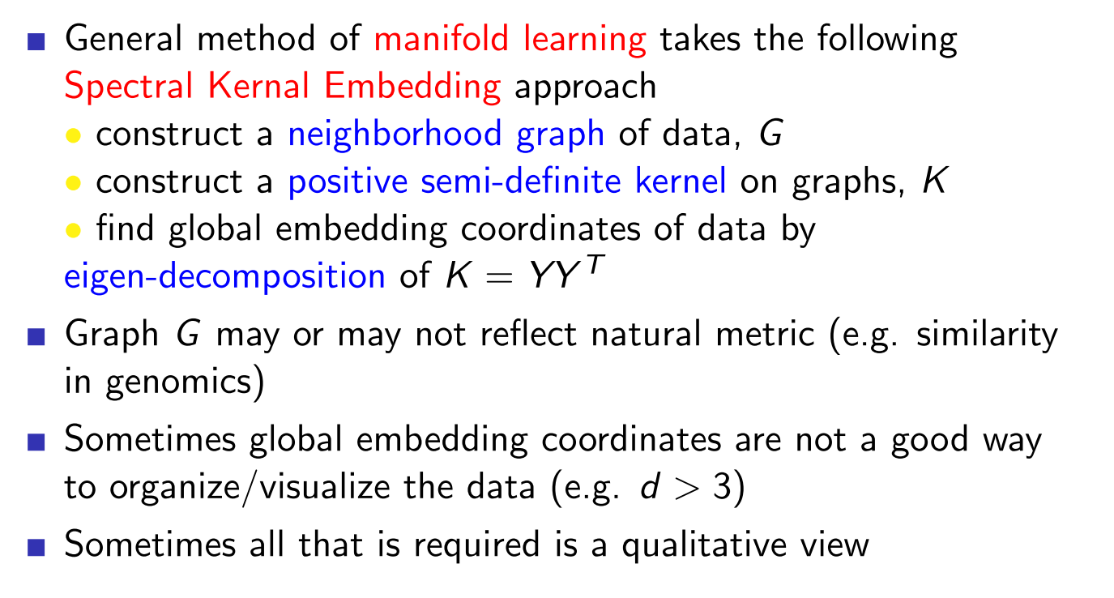
Reflection
Data often contain singularities, not simple manifolds!

Slide 42
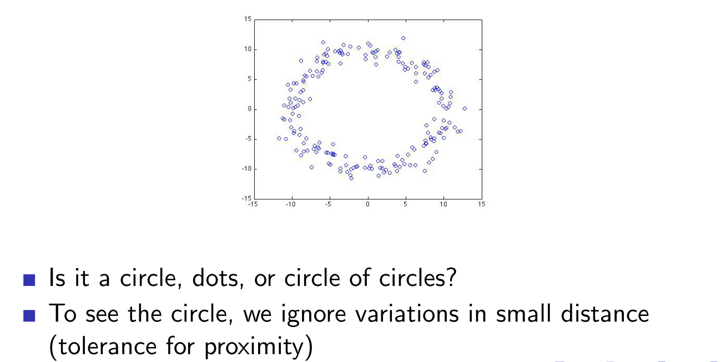
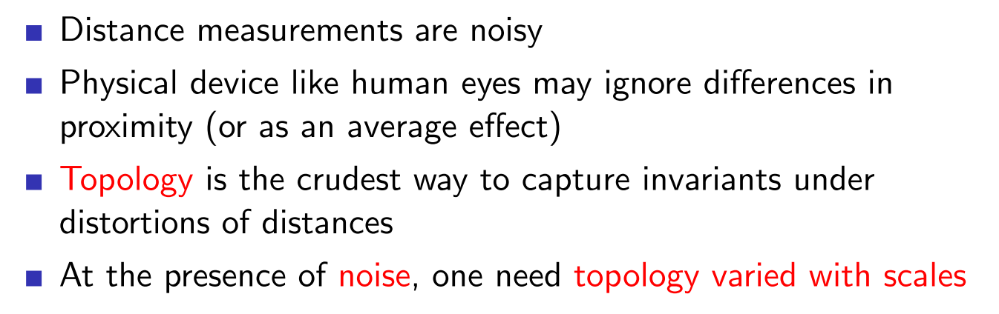
Topology with Scale

Slide 43
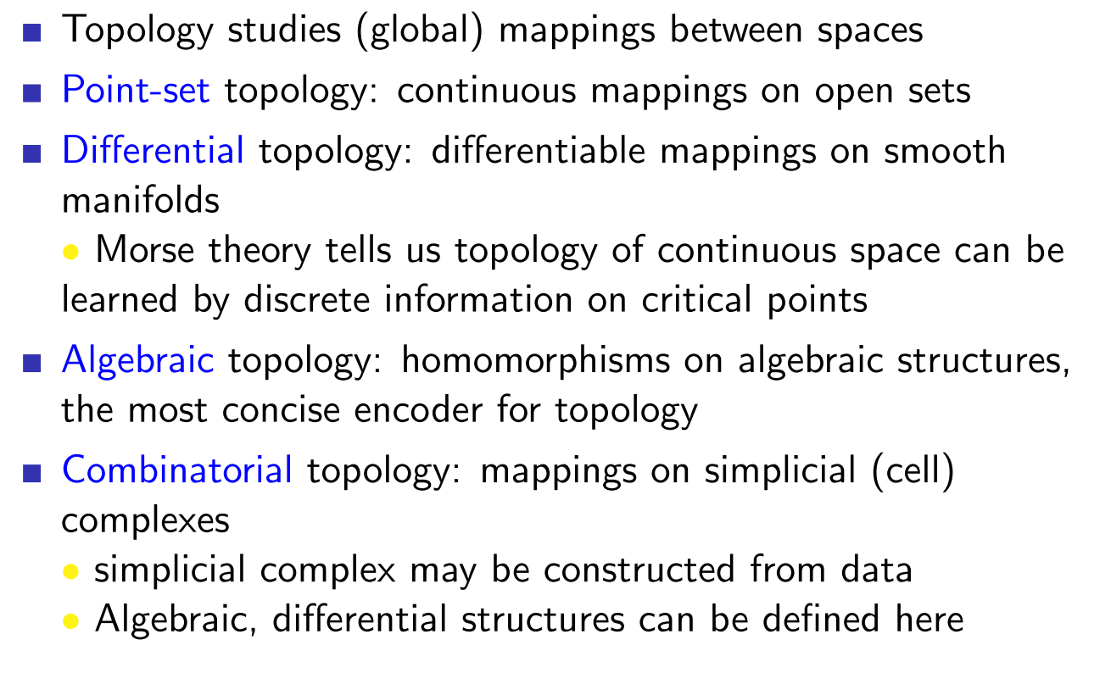
What kind of Topology for Data Analysis

Slide 44
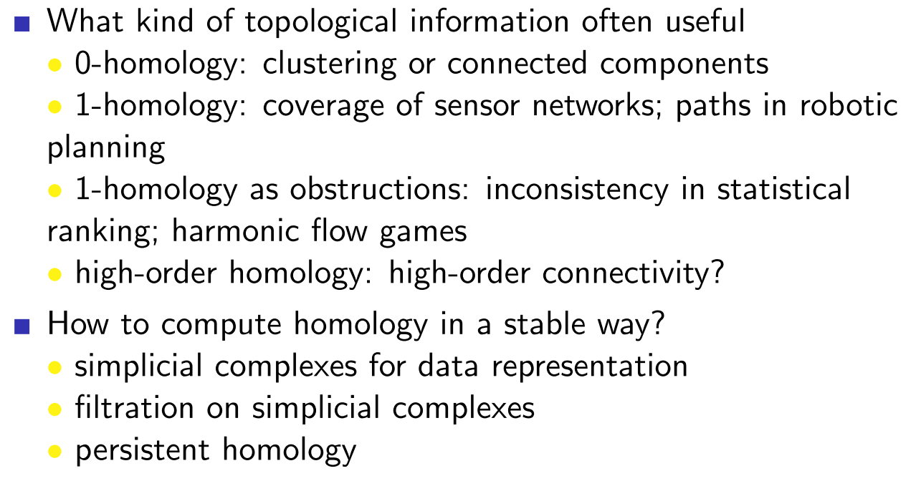
Topological Data Analysis

Slide 45
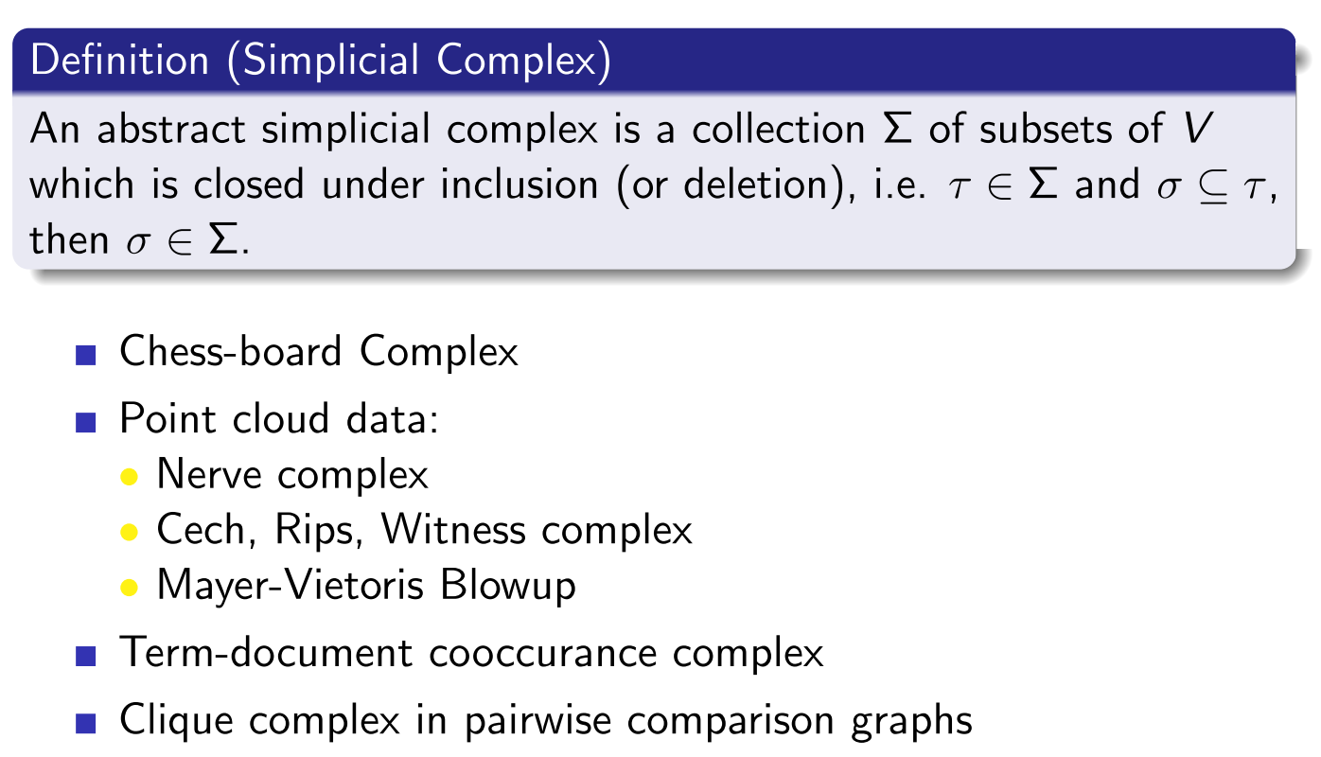

Slide 46
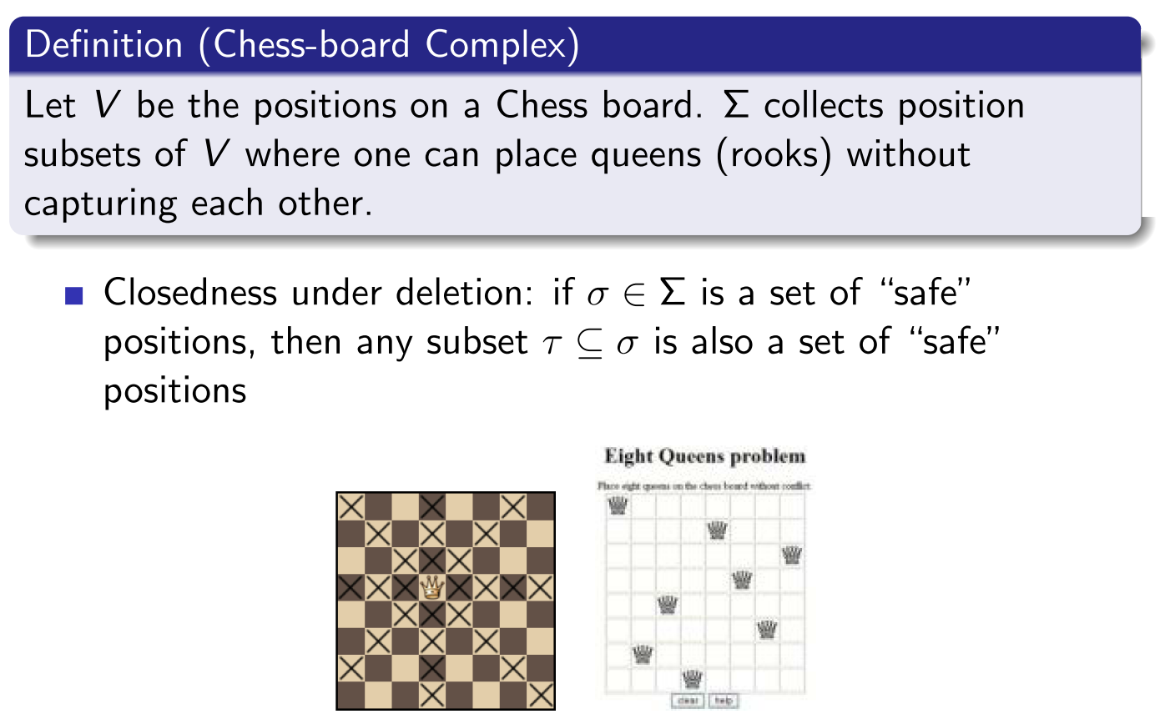

Slide 47
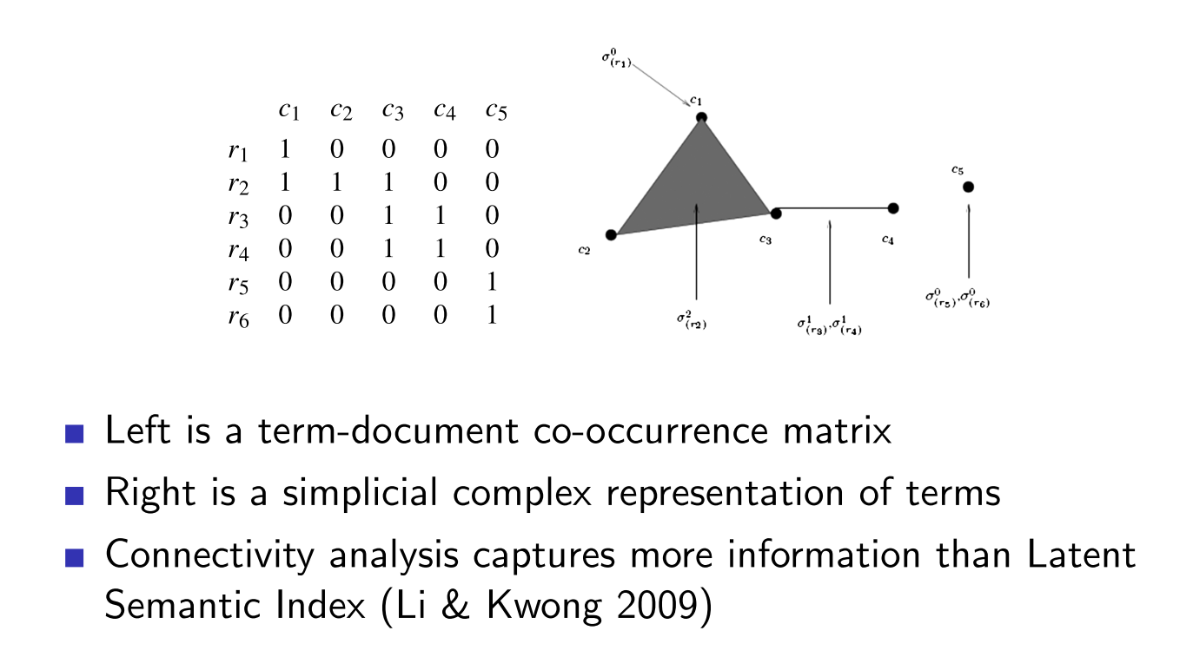
Term-Document Cooccurence Complex

Slide 48
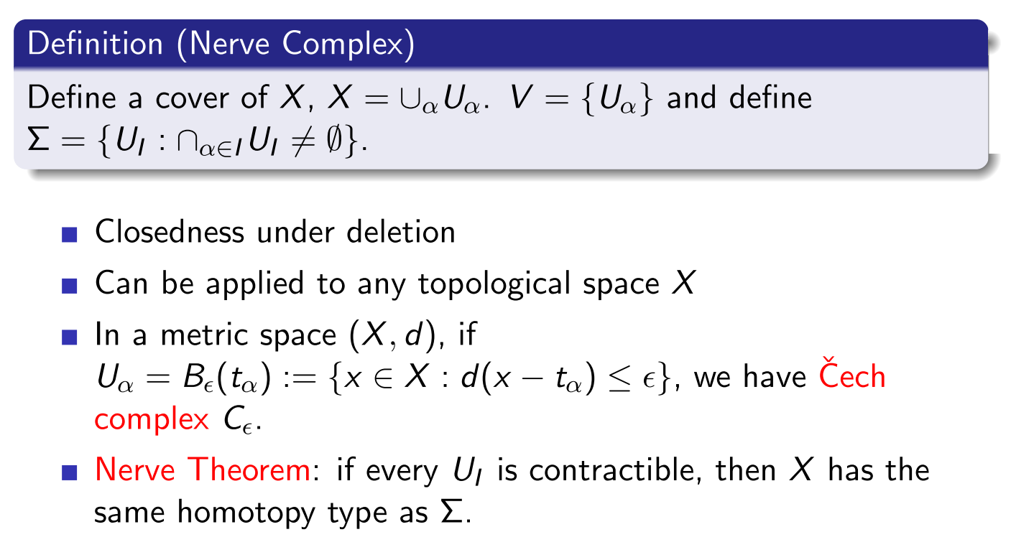

Slide 49
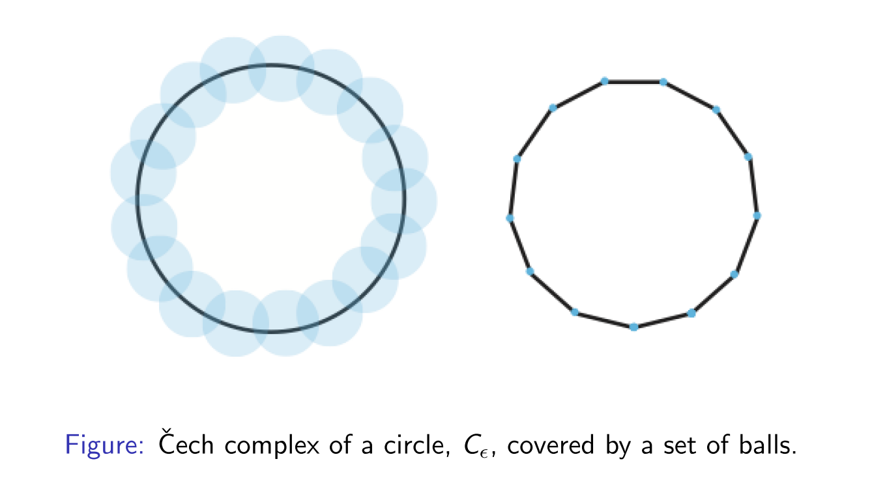
Example

Slide 50
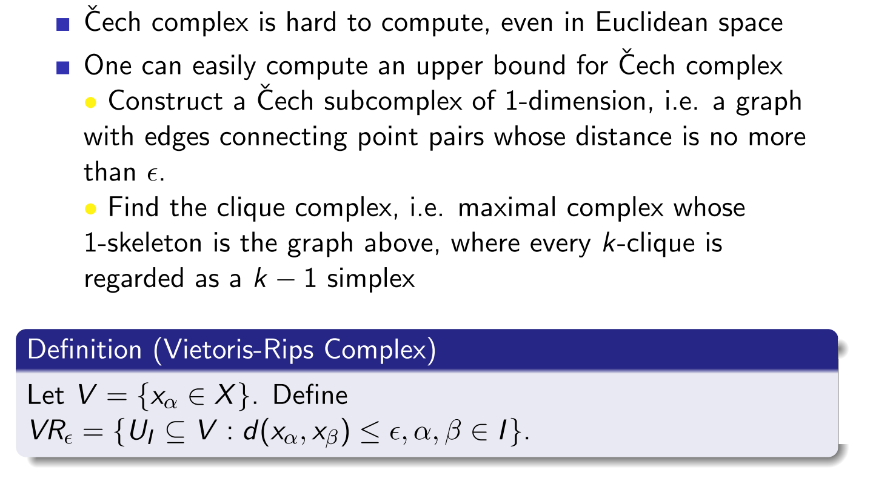

Slide 51
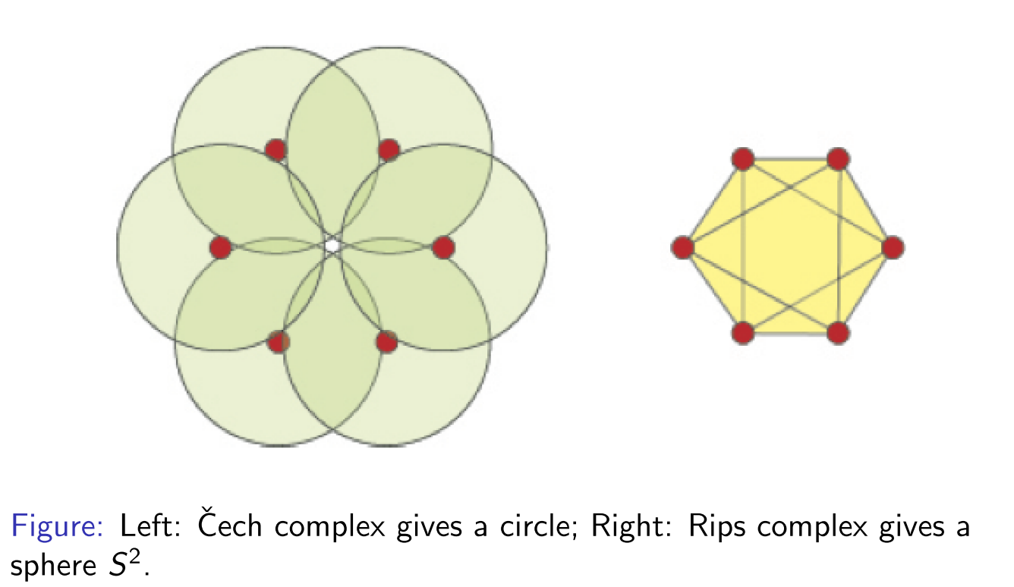
Example

Slide 52
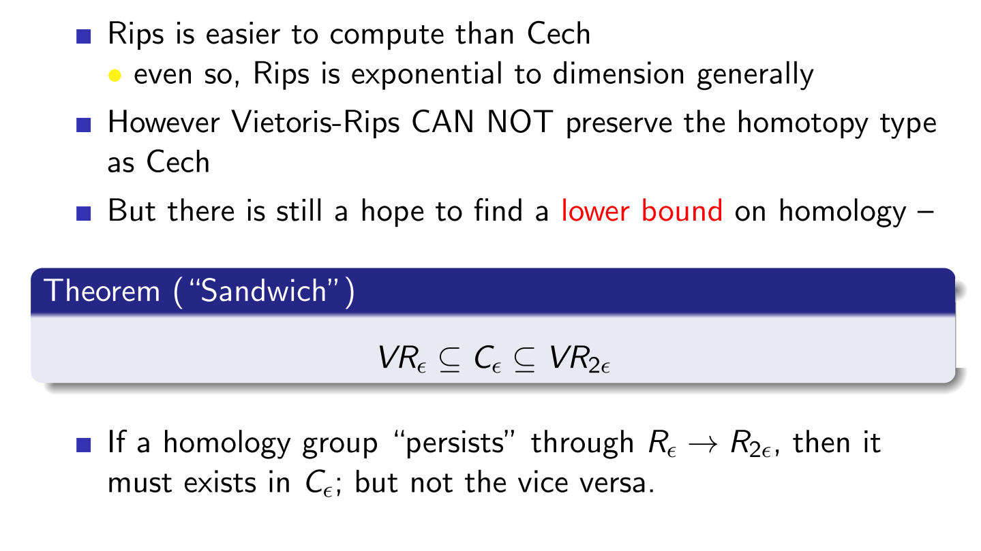

Slide 53
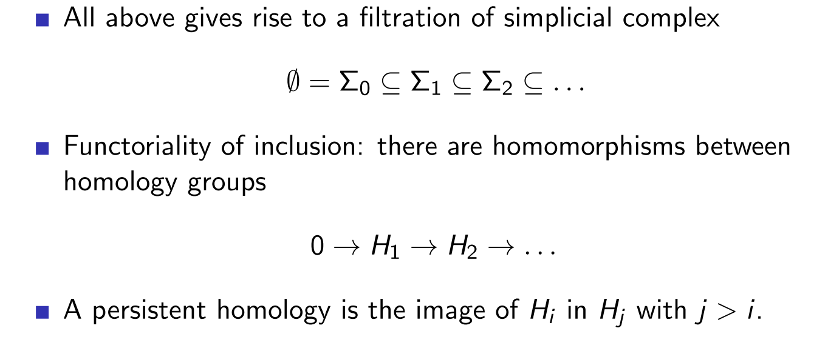
Persistent Homology: algebraic definition

Slide 54
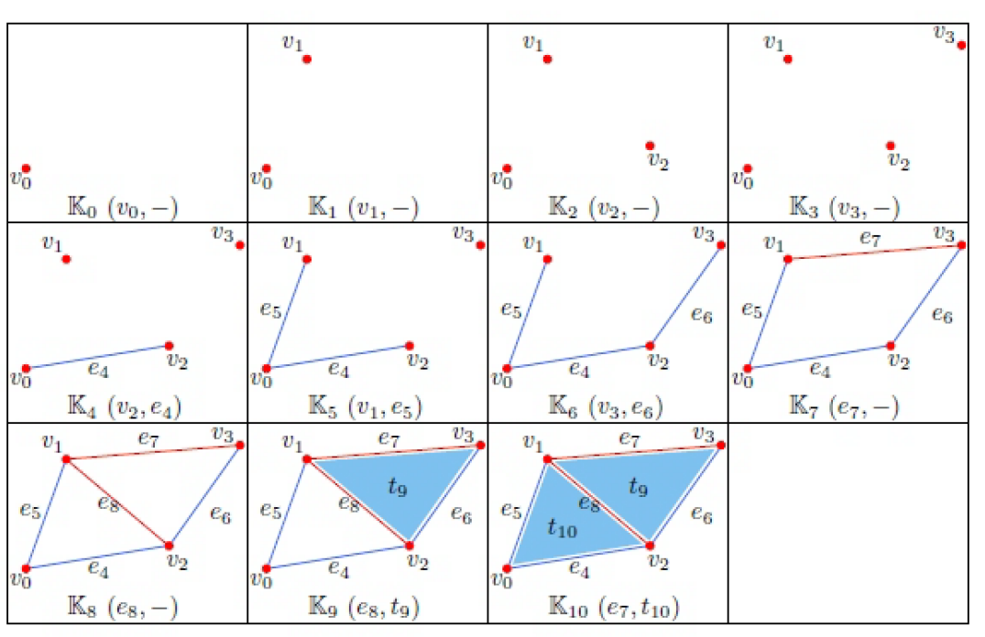
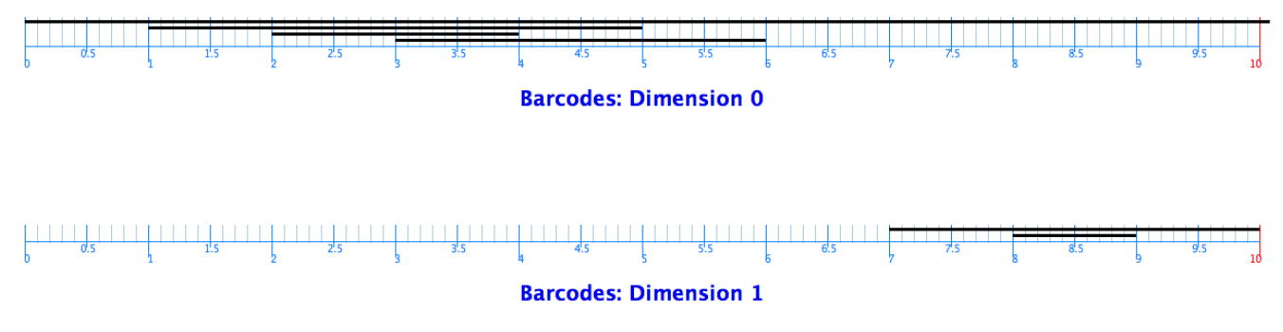
Persistent Homology as online algorithm to track topology changes (by JPlex)

Slide 55
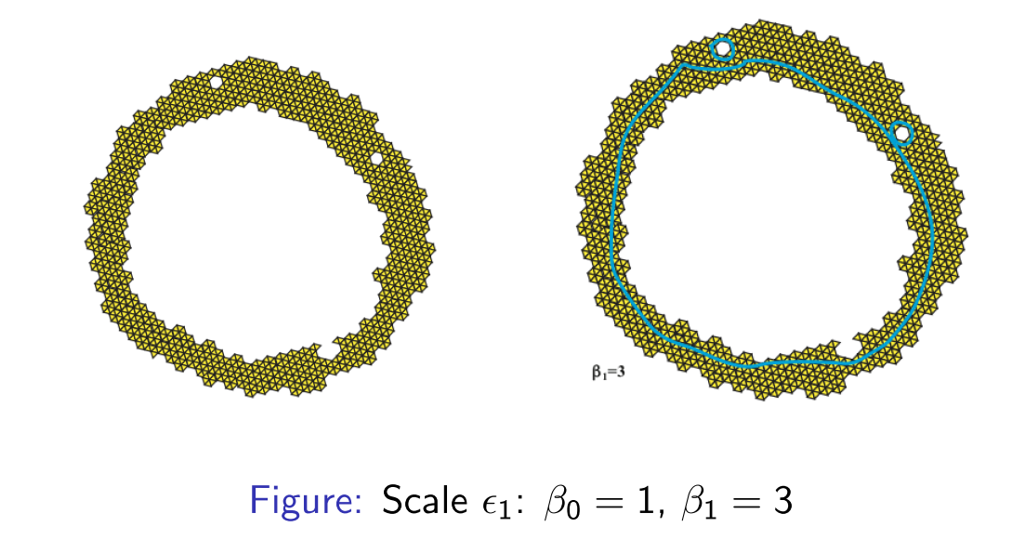
Example: Persistent 1-Homology of Cech Complex

Slide 56
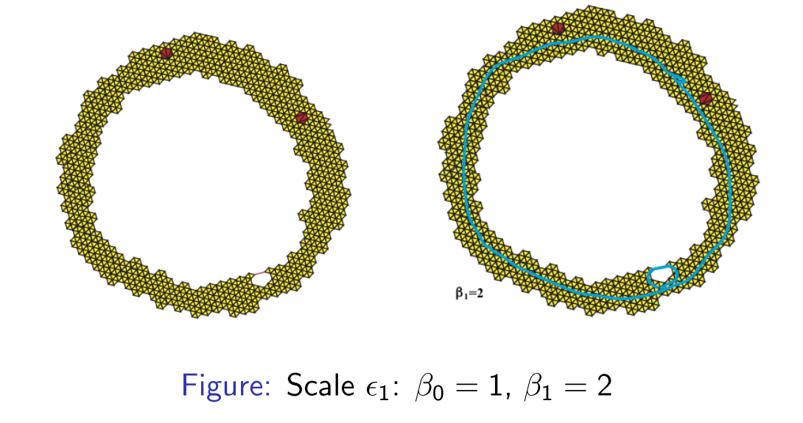
continued

Slide 57

Example: Persistent 0-Homology of Functional sublevel sets

Slide 58


Application: Sensor Network Coverage

Slide 59



Application: Topology of Natural Image 3x3 Patches (Carlsson et al. 2008)

Slide 60
Summary
Define a simplicial complex from data
Form a filtration on the simplices such that inclusion order is respected
Scale in Cech, RIPS complexes
Functional (sub/super-) level sets
Persistent homology is to track homology evolution in the filtration
What about Hodge Theory?
Provides special basis (harmonic) for real homology classes
Seminar: Applied Hodge Theory, May 8, 4-5pm, NTU

